Slide 1

Unit – 3 Classes, Objects and Methods

Slide 2
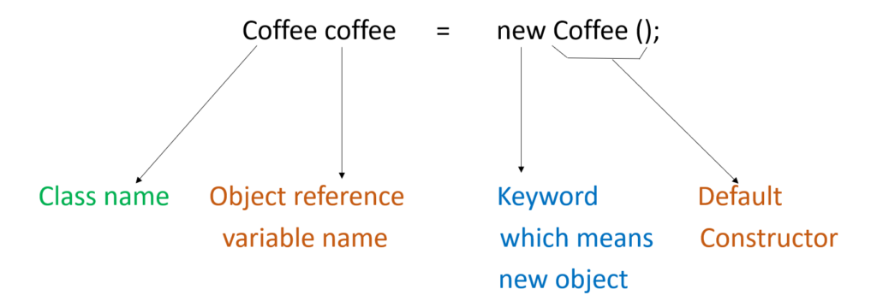
In Java, new is a keyword used for class instance creation and dynamic memory allocation, and is often informally called the new operator.
It allocates memory dynamically for the object in heap memory at runtime.
It automatically invokes the constructor and returns the object reference.
The new operator is used to create an object of a class in Java.
new operator

Slide 3
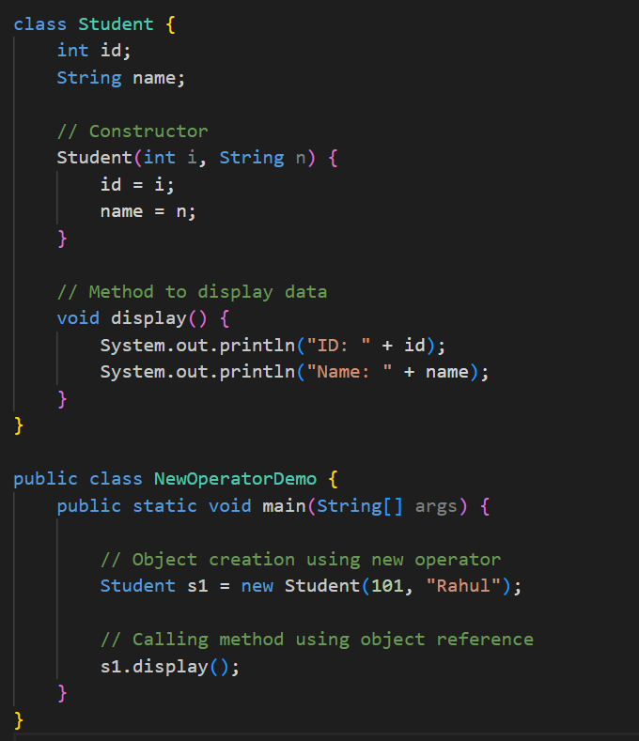
new operator
Code Example

Slide 4
new operator
Code Example
Output:
ID: 101
Name: Rahul
Explanation:
In this code, new Student(101, "Rahul") creates a Student object, allocates memory, and calls the constructor to initialize id and name.
The reference returned by new is stored in s1, which is then used to call the display() method.

Slide 5
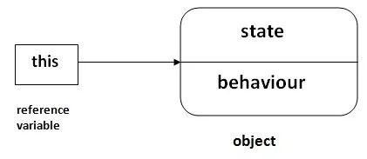
The this keyword refers to the current calling object of a class.
It is used to differentiate between instance variables and local variables having the same name.
It can also be used to call the current class constructor or pass the current object.
It can be used to return the current object from a method.
this keyword

Slide 6
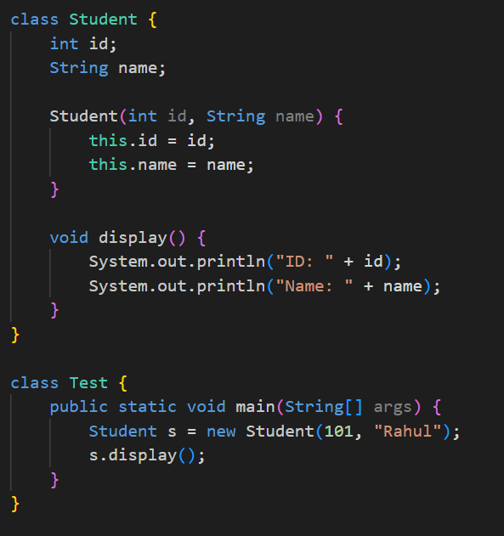
this keyword
Example

Slide 7
this keyword
Example
Output:
ID: 101
Name: Rahul
Explanation:
The this keyword refers to the current object of the class.
It is used to differentiate instance variables from constructor parameters when both have the same name.

Slide 8
static Keyword
The static keyword in Java is used to declare variables, methods, nested classes, and static blocks.
Static members belong to the class, not to individual objects.
Memory for static members is allocated only once and shared by all objects.
Static members can be accessed using the class name without creating an object.
The main() method is static so that it can be executed without object creation.

Slide 9
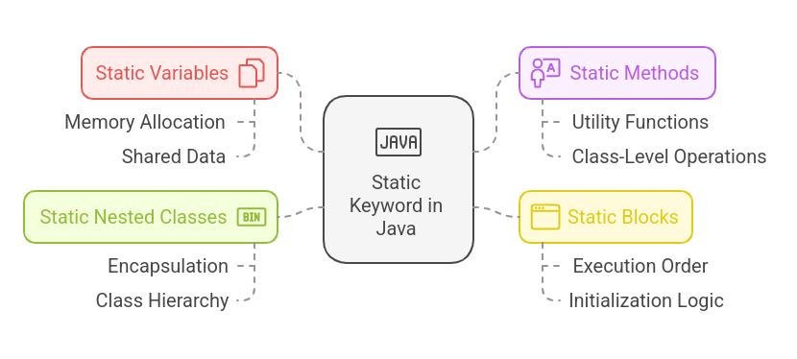
Static Keyword

Slide 10
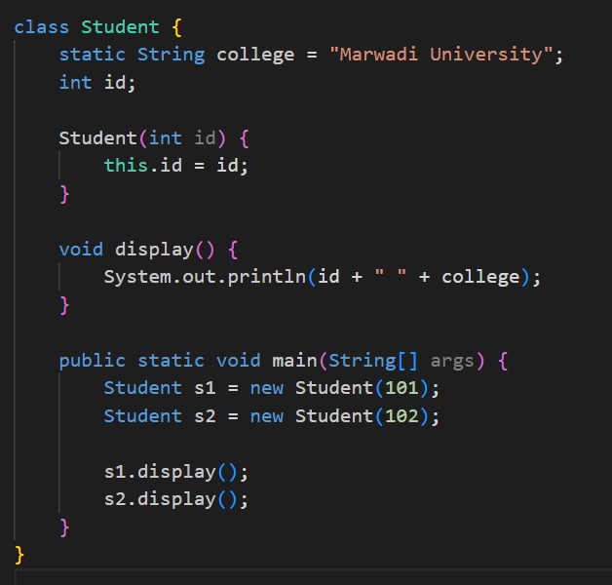
Static Variable Example

Slide 11
Static Variable Example
Output:
101 Marwadi University
102 Marwadi University
Explanation: The static variable college is shared by all objects of the class.

Slide 12
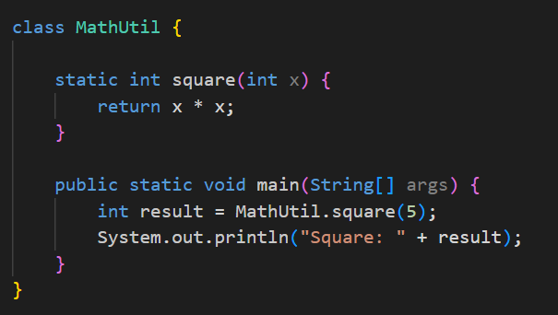
Static Method Example

Slide 13
Static Method Example
Output:
Square: 25
Explanation: The static method square() is called using the class name without creating an object.

Slide 14
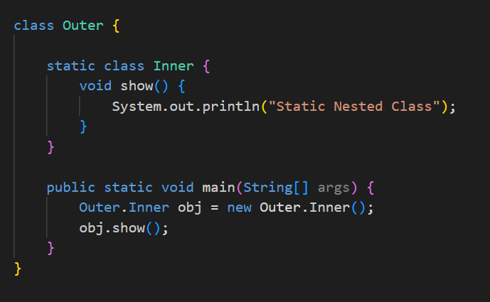
Static Nested Class Example

Slide 15
Output:
Static Nested Class
Explanation: A static nested class does not require an object of the outer class.
Static Nested Class Example

Slide 16
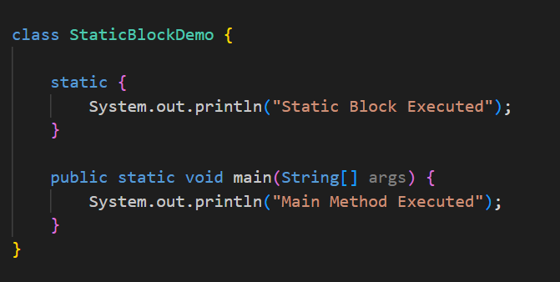
Example of Static Block

Slide 17
Example of Static Block
Output:
Static Block Executed
Main Method Executed
Explanation: The static block runs first when the class is loaded, before the main() method is executed.

Slide 18
finalize() Method
The finalize() method is called by the Garbage Collector before an object is destroyed.
It is used to perform cleanup activities like releasing resources.
It is defined in the Object class and available to all Java classes.
Important Points:
It is not a reserved keyword in Java.
It is called only once per object by the Garbage Collector.
The finalize() method is deprecated since Java 9 and not recommended now.
Syntax:
protected void finalize() throws Throwable

Slide 19
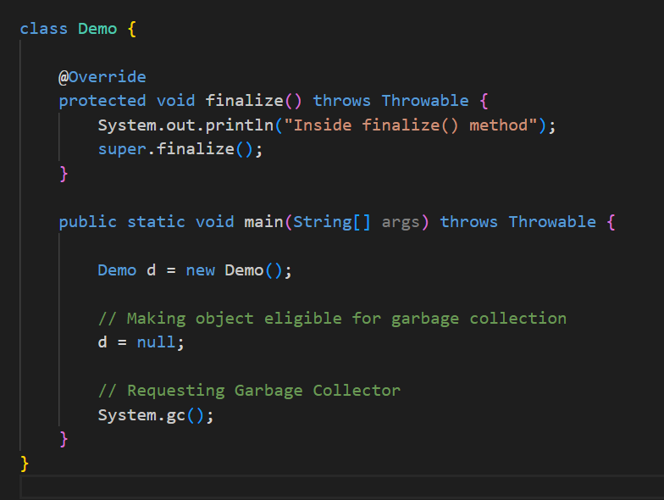
Example: Overriding finalize() Method

Slide 20
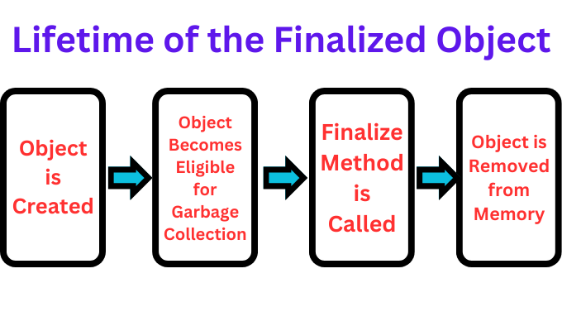
Example: Overriding finalize() Method
Output:
Inside finalize() method
Explanation:
When the object becomes unreachable, the Garbage Collector may call finalize().
The overridden finalize() method performs cleanup before object destruction.

Slide 21
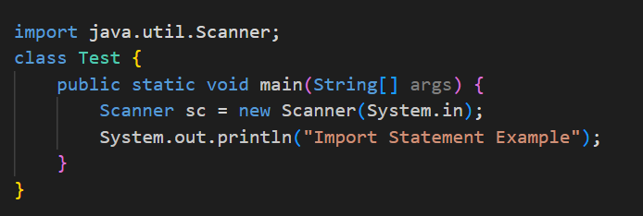
Import Statement
The import statement in Java is used to make classes, interfaces, or packages available so that their fully qualified names are not required.
Key Points:
Reduces code verbosity
Comes after package statement (if any)
Types: single-class import, package import
Example:

Slide 22
Output:
Import Statement Example
Explanation:
Scanner belongs to java.util
Without import, we would need java.util.Scanner
Import Statement

Slide 23
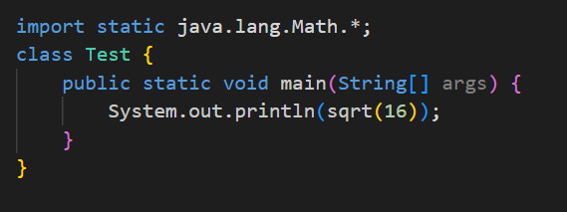
Static Import
Static import allows accessing static members of a class directly without using the class name.
Key Points:
Introduced in Java 5
Used for constants and static methods
Improves readability when used carefully
Example:

Slide 24
Static Import
Output:
4.0
Explanation:
sqrt() is a static method of Math
Static import removes the need to write Math.sqrt()

Slide 25
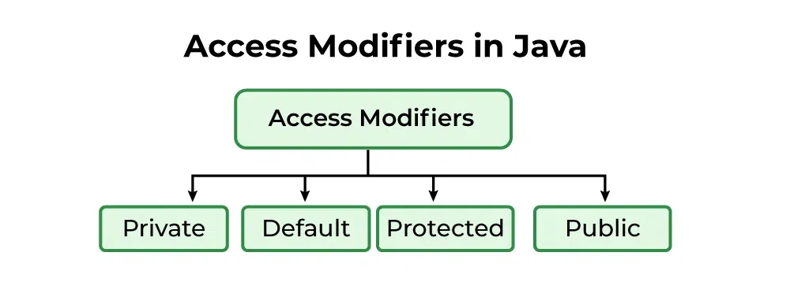
Access Control
Access control in Java determines where a class, method, variable, or constructor can be accessed.
It is implemented using access specifiers.
There are 4 types of access specifier/modifiers in Java:

Slide 26
Access Specifiers
private:The private access specifier allows access only within the same class.
default (no access specifier): When no access specifier is used, members are accessible only within the same package
protected: The protected access specifier allows access within the same package and in subclasses of other packages.
public: The public access specifier allows access from anywhere in the program.

Slide 27
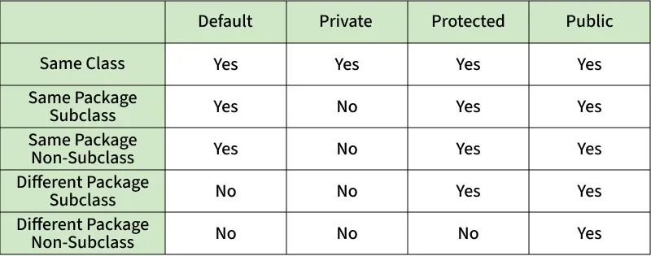
Comparison Table of Access Specifiers

Slide 28
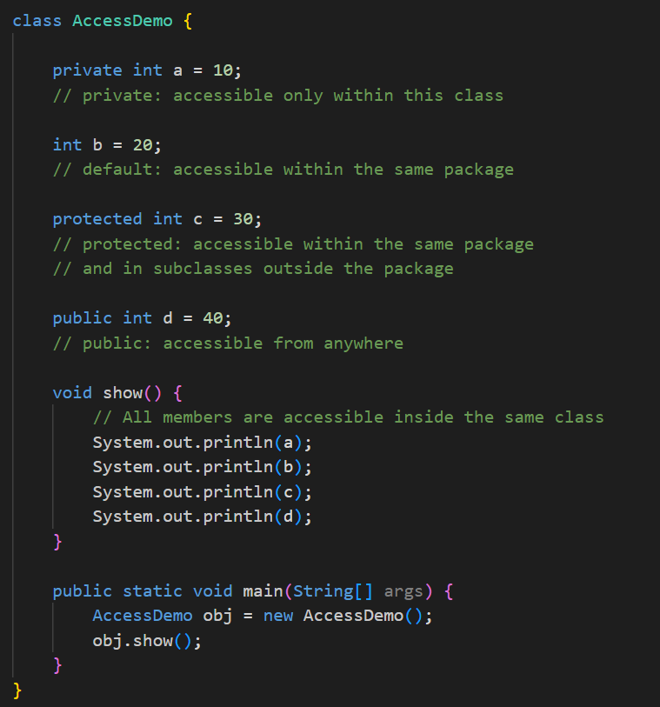
Access Specifiers Example

Slide 29
Output:
10
20
30
40
Explanation:
private → same class only
default → same package
protected → same package + subclass
public → everywhere
Access Specifiers Example

Slide 30
A nested class in Java is a class that is declared inside another class.
When the nested class is declared using the static keyword, it is called a static nested class.
Important Points:
Declared inside another class
Uses the static keyword
Does not require an object of the outer class
Can access only static members of the outer class
Nested Class

Slide 31
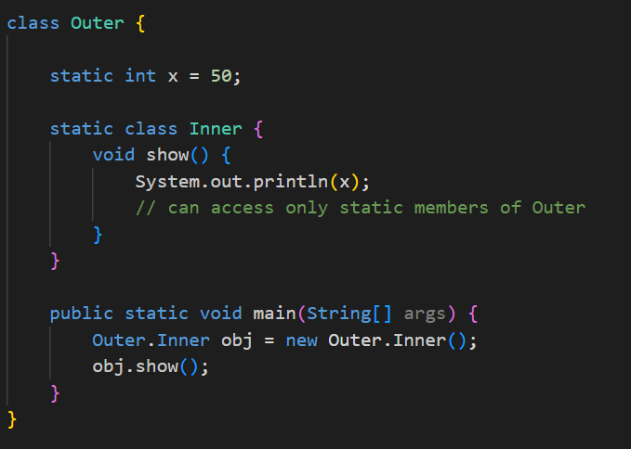
Static Nested Class Example

Slide 32
Output:
50
Explanation:
Inner is a static nested class
It is accessed using Outer.Inner
No outer class object is required
It can access only static variable x of Outer
Static Nested Class Example

Slide 33
An inner class in Java is a non-static class that is declared inside another class.
It can access all members (data and methods) of the outer class, including private members.
Important Points:
Declared inside another class without static
Requires an object of the outer class
Can access both static and non-static members of the outer class
Used to logically group classes and improve encapsulation
Inner class

Slide 34
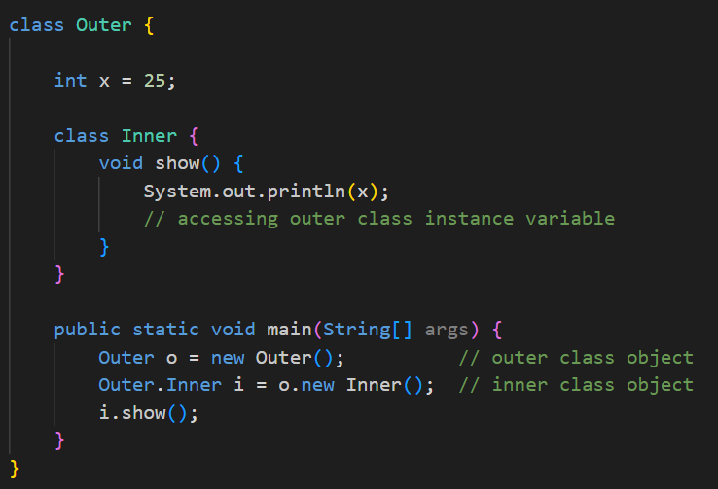
Inner class Example

Slide 35
Output:
25
Explanation:
Inner is a non-static inner class
It is created using the outer class object
Inner class can directly access x of the outer class
Inner class Example

Slide 36
An anonymous inner class in Java is a class without a name that is created at the time of object creation to provide an immediate implementation of an interface or an abstract class.
Important Points:
Has no class name
Used for one-time use
Created using new keyword
Commonly used in event handling
Cannot define constructors
Anonymous Inner Class

Slide 37
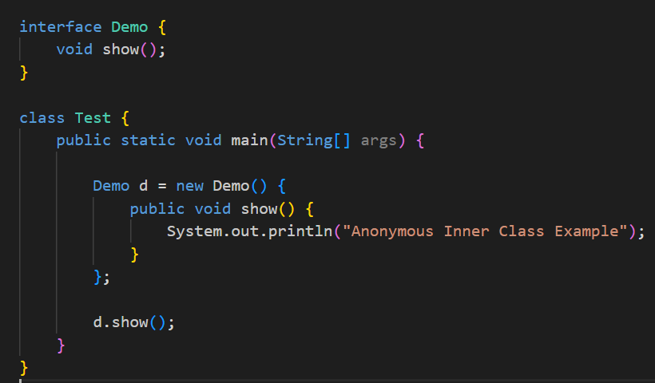
Anonymous Inner Class Example

Slide 38
Output:
Anonymous Inner Class Example
Explanation:
No separate class is created
Interface Demo is implemented directly inside main()
The anonymous inner class overrides the show() method
Used when a class is required only once
Anonymous Inner Class Example

Slide 39
Thank You
Prepared by - Prof. Abhishek Chauhan

